Slide 1
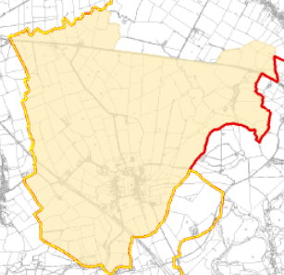
Ludgershall Parish

Slide 2
Today’s Proposed Agenda
Pre-meeting (5-10mins)
  – how many people would use a joint bus service with Brill & Oakley
  – attendee contact details
Introduction (15 mins)
  VALP status
  Parish Plan & Neighbourhood Plan
  What should be the Area
Initial actions (30-45 mins)
  Form a working group. 10-12 people ideal but more is better than fewer.
  Decide a plan of contacting the whole community
  Web page/site
Housekeeping (5 mins)
  Formal meeting frequency
  Reporting frequency to PC

Slide 3
VALP status
3rd attempt slightly behind schedule & expected in October
Sustainability Appraisal is taking longer than expected
Public consultation expected in November
Submit to government in January

Slide 4
VALP Headline
Number of new dwellings scaled back to 27,000 (from 33,300) due to updated growth forecasts
approx 50% have already been committed (ie already under construction or have planning approval)

Slide 5
Draft VALP 2016
Smaller, less sustainable villages which have relatively poor access to services and facilities. It is expected that small scale development could be accommodated at smaller villages without causing environmental harm.
This level of development is also likely to help maintain existing communities. The plan will identify how the housing requirement will be delivered at smaller villages, either through neighbourhood plans or at the next stage of the local plan, but does not make allocations at this stage
 | required | Commited 2015/16 | Completions 2013/16 | Residual requirement
Ludgershall | 8 | 2 | 2 | 4

Slide 6
Draft VALP 2016
The Issues and Options consultation document outlined that to deliver the significant level of growth in Aylesbury Vale by 2033, the council needed to explore the possibility of a new settlement
The initial constraint mapping process resulted in a shortlisting of 12 broad ‘areas of search’ :
  1 Arncott
  2 Cheddington
  3 Doddershall
  4 Haddenham
  5 Granborough
  6 Land around Oakley/Little London and Long Crendon
  7 Marsh Gibbon
  8 Steeple Claydon
  9 Stewkley
  10 Turweston Airfield
  11 Waddesdon
  12 Winslow

Slide 7
Community Led Plan (CLP)
Formerly known as Parish Plan
Local communities can set out their own needs and priorities and draw up an action plan to address these.
They cover all issues for the parish, not just planning issues, providing an opportunity for everyone in a community to make themselves heard
CLPs do not form a statutory planning document and cannot allocate sites for development. However, they are considered alongside planning applications but cannot be given any formal weight.
As such they do not require a rigorous evidence base.
They are cost-free and have certainty they will be adopted.
Takes 2-3 months

Slide 8
CLP
For example, CLPs can include community views and actions to address the following :
  more open spaces
  more effective public transport
  more affordable housing
  better access to health care
  provision of leisure facilities such as a football pitch
  anti social behaviour
  speed limits
  parking
  holiday cottages
  Neighbourhood Watch

Slide 9
Neighbourhood Development Plan (NDP)
New tier of planning documents introduced by the Localism Act in 2011. They help communities have a greater say in shaping future development.
Primarily aimed at areas where there is likely to be significant future growth, usually larger settlements.
Optional and absence does not mean more vulnerability to future development.
NDP allows allocation of sites where you would like to see future development e.g. for housing, employment or community facilities.

Slide 10
NDP
Allow for more detailed, neighbourhood specific planning policies, which build upon the detail identified in VALP.
Cannot be used as a tool for hindering development and they cannot plan for less development than is set out in VALP
Once “made” it forms a statutory planning document for the parish and is used to assess planning applications along with VALP.
Because it is a statutory document, it has to conform with the VALP and national policy.

Slide 11
NDP
Must also go through an examination, which requires technical evidence to inform the policy decisions.
If found sound must then go through a referendum, where 50% or more of the votes must be in favour for the NDP in order for it to be brought into force.
This evidence is similar to that which must be produced for the Vale of Aylesbury Plan, but on a much smaller scale for the neighbourhood level.
Likely costs £20k. Grants can be applied for up to 31 January 2018 and must be £1000 minimum up to £9000 – however, the money must be spent by March 2018 !
Takes 1-3 years

Slide 12
NDP
might include:
The development of housing, including affordable housing and bringing vacant or derelict housing back into use.
Provision for businesses to set up or expand their premises.
Transport and access (including issues around roads, cycling, walking and access for disabled people).
The development of schools, places of worship, health facilities, leisure and entertainment facilities, community and youth centres and village halls.
The restriction of certain types of development and change of use, for example to avoid too much of one type of use.
The design of buildings.
Protection and creation of open space, nature reserves, allotments, sports pitches, play areas, parks and gardens, and the planting of trees.
Protection of important buildings and historic assets such as archaeological remains.
Promotion of renewable energy projects, such as solar energy and wind turbines

Slide 13
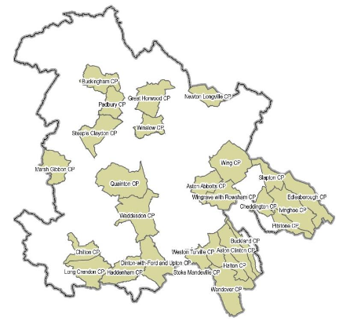
NDP - who is doing or has done one
Currently 34 parishes
11 have been “made”

Slide 14
NDP
Area it covers can be
  Same
  Greater (eg include neighbouring area)
  Smaller (eg 30mph limits only)
than the parish boundary

Slide 15
Initial actions
Initial phase a multi-step process:
Set up online information source
Collate contact details for the whole parish
Inform whole parish through email, txt, web or post
Terms of Reference from PC
Agree a questionnaire
Publish questionnaire
Gather, collate & rank answers
Publish results
July / Aug
Sept / Oct

Slide 16
Initial Actions
Form a working group chaired by Tom
  Parish Councillors
  Interested parishioners
Set up & maintain web page/site
  Information source
  Background documents
Contact the whole community (171 houses, 400+ residents)
  Inform
  Build contact list
today
July
July/Aug

Slide 17
Housekeeping
Working group requires ratification by PC & terms of reference
Ad-hoc or regular meetings
  Timing & frequency
Reporting to PC

Slide 18
Contact opt-in form
Details will be stored securely by the Parish Clerk under Data Protection rules and used only for communications about official Parish Council matters. You may withdraw at any time.
address
name(s)
phone
email

